Slide 1
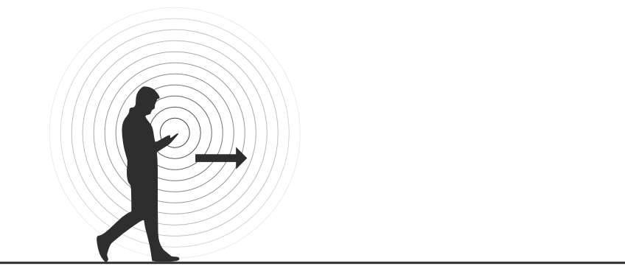
Distributed Crowd Flow Analysis Using Passive Packet Sniffing

Slide 2
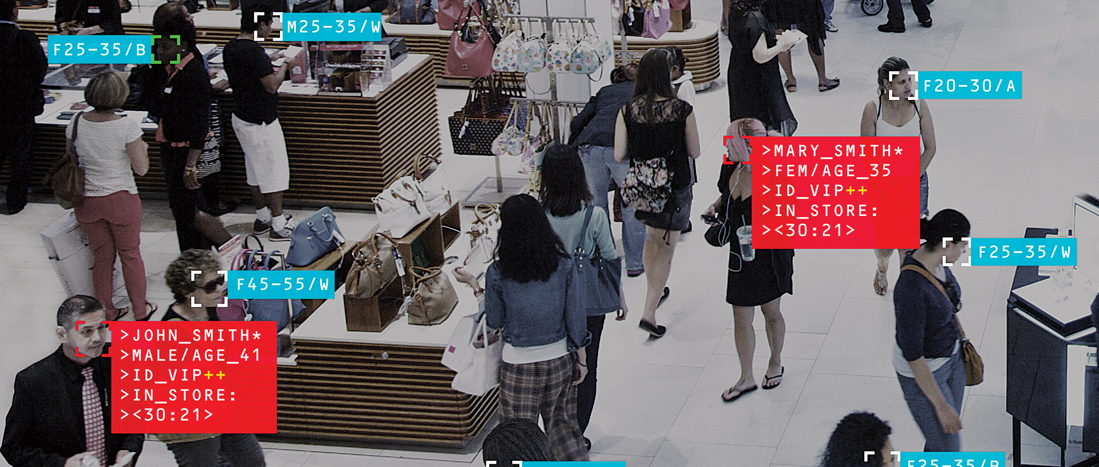
Introduction
Problem
Crowd analysis
Large area
Big brother?
Notes:
Increasing density within cities requires efficient routing
Devices send shit
We sniff shit
Focus on flow distribution across multiple exits (can’t be derived using simply counting people)
No per person basis tracking – no storage of personal info of a device

Slide 3
High level overview
Low power strategically placed nodes
Interconnectivity between nodes
Wi-Fi sniffing
Scalable topology
Uplink only reports flow magnitude
Notes:
passing devices
one-hop neighboring nodes

Slide 4
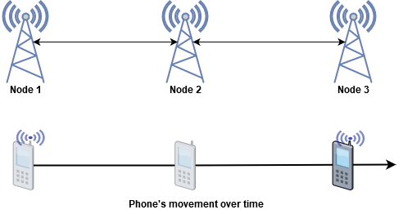
Algorithms 1/2
Direct and indirect detection
Notes:
Only store broadcasted from neighbours
Geometric graph
Average degree scalable

Slide 5
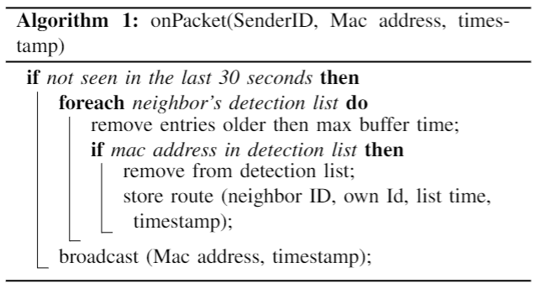
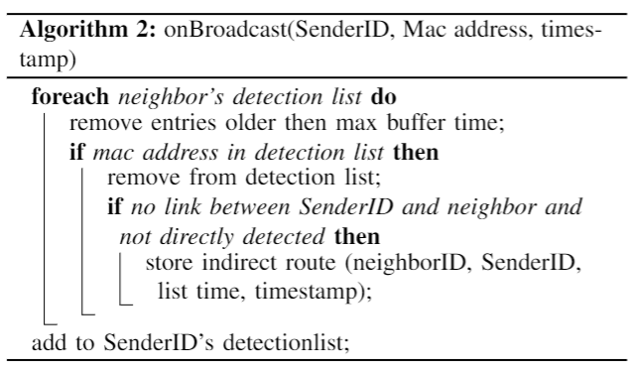
Algorithms 2/2

Slide 6
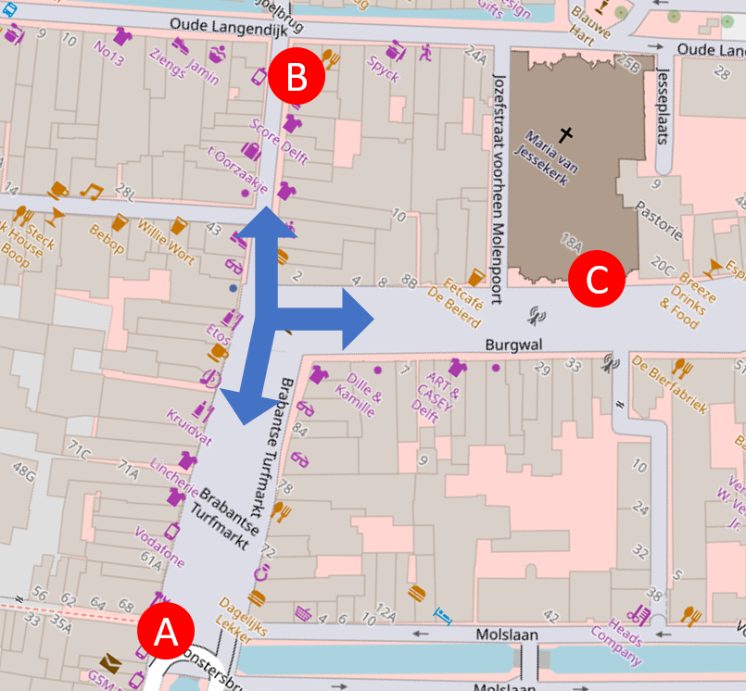
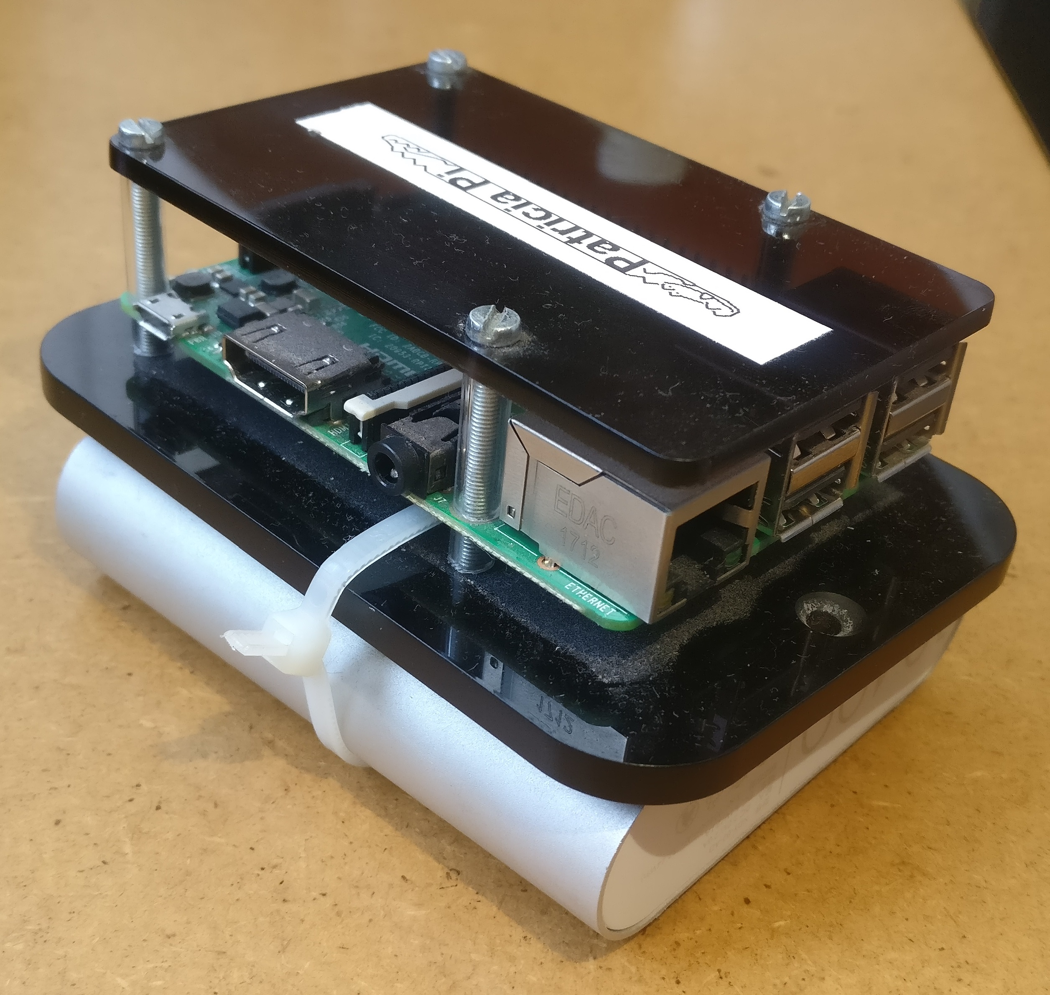
Experiment
Notes:
Three way junction, minimal leakge & market (more people)
Capture raw data, ran simulation afterwards to split algorithm development and measurements.
Simulate receiveing packets by rerunning the recordings
Measure 30 sec video every 5 minute, extrapolate as ground truth

Slide 7
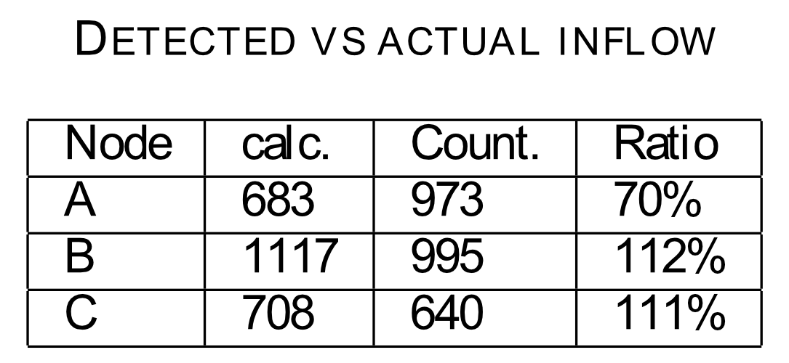
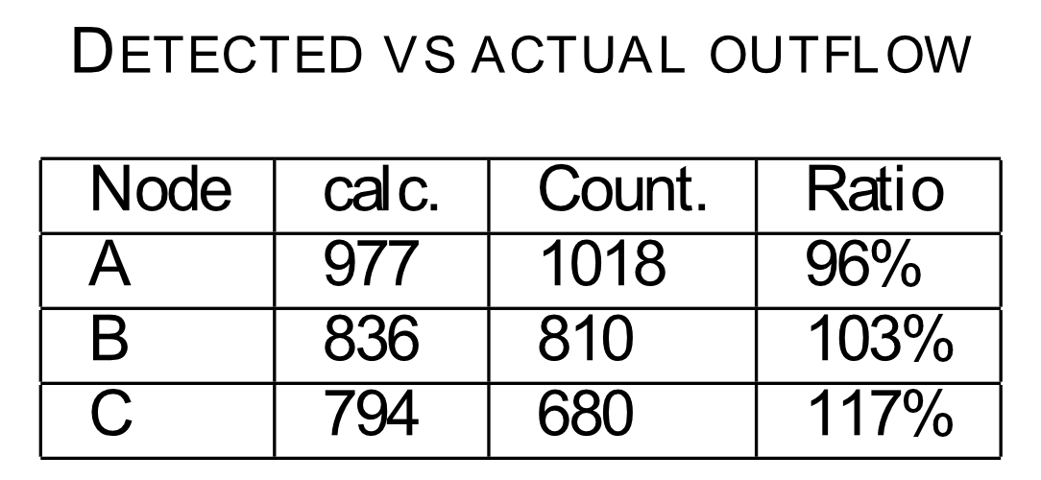
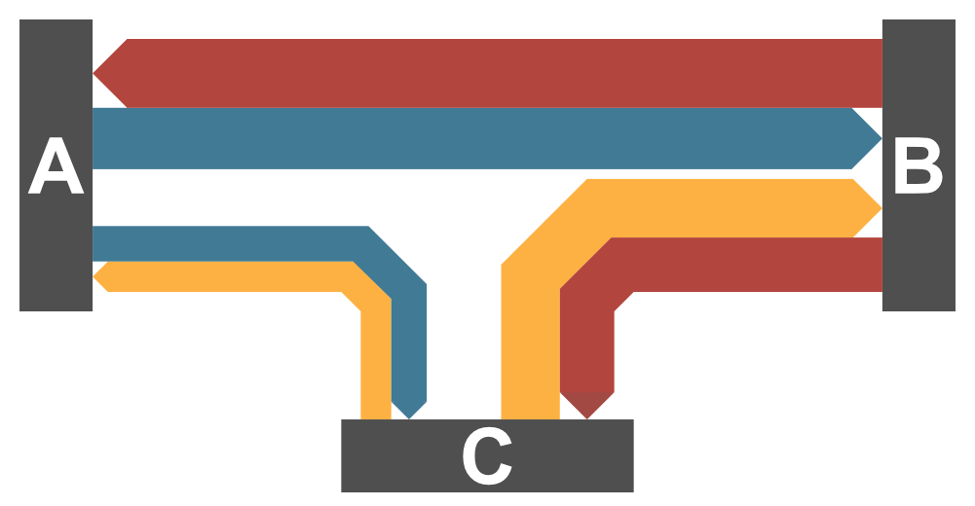
Result
Notes:
Duidelijk uitleggen hoe getallen berekend zijn Cout = Ain * ratio (a->c) + Bin * ratio (b->c)

Slide 8
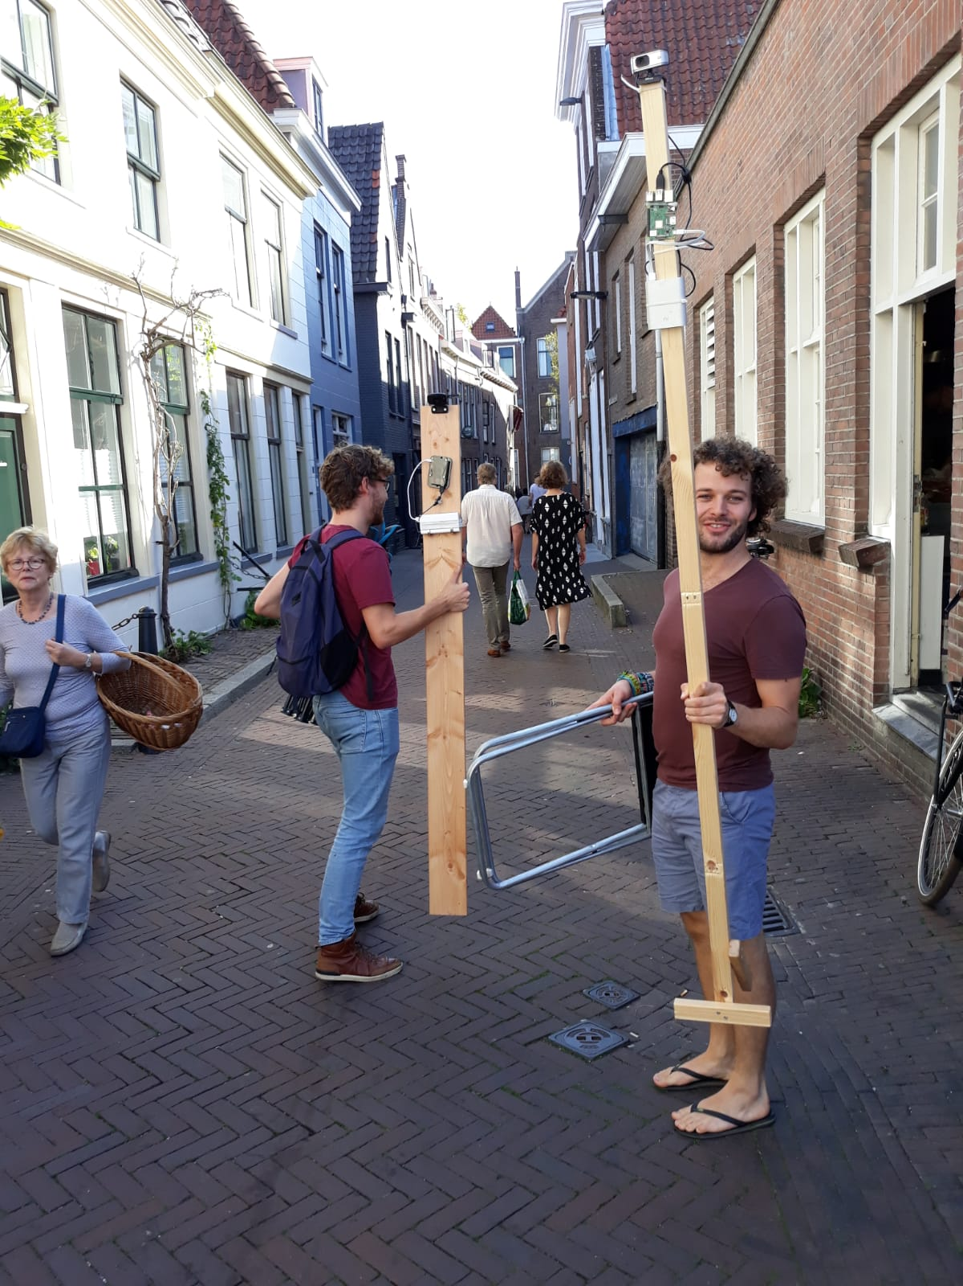

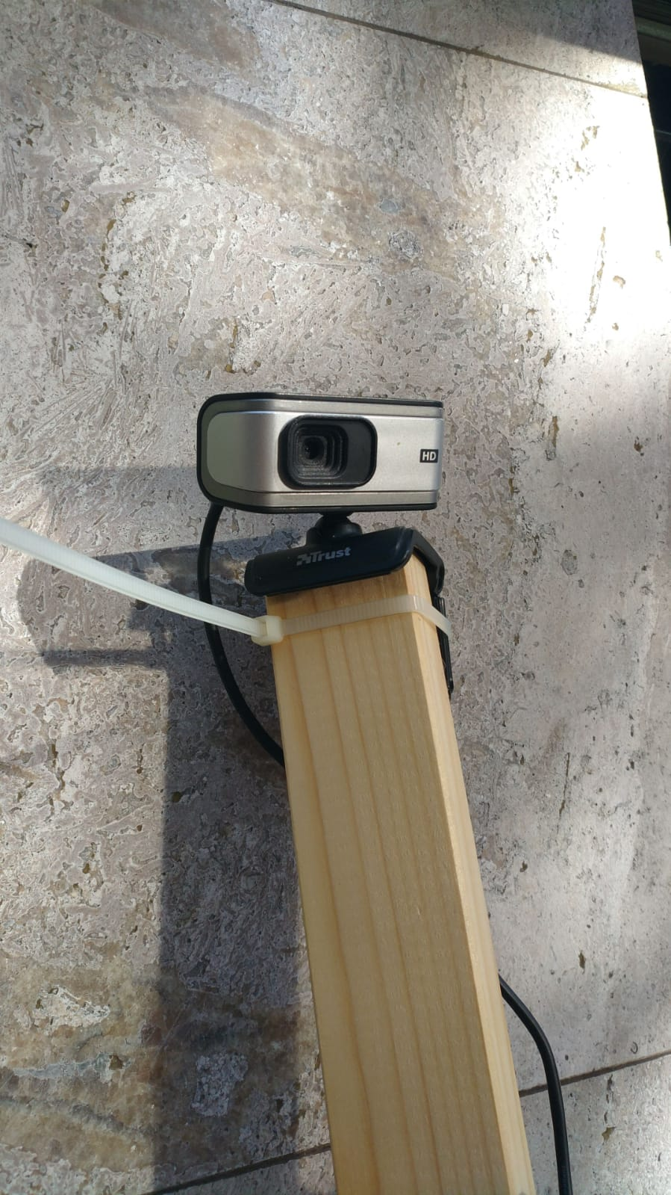
Discussion
Notes:
Much work ivensted in automated failing
To close nodes- problem

Slide 9
Conclusion
Algorithms developed for a large distributed network
Show flow distribution on junction
Experimental results shows correlation between counted persons and detected devices
Developed tools for data visualization (demo)

Slide 10
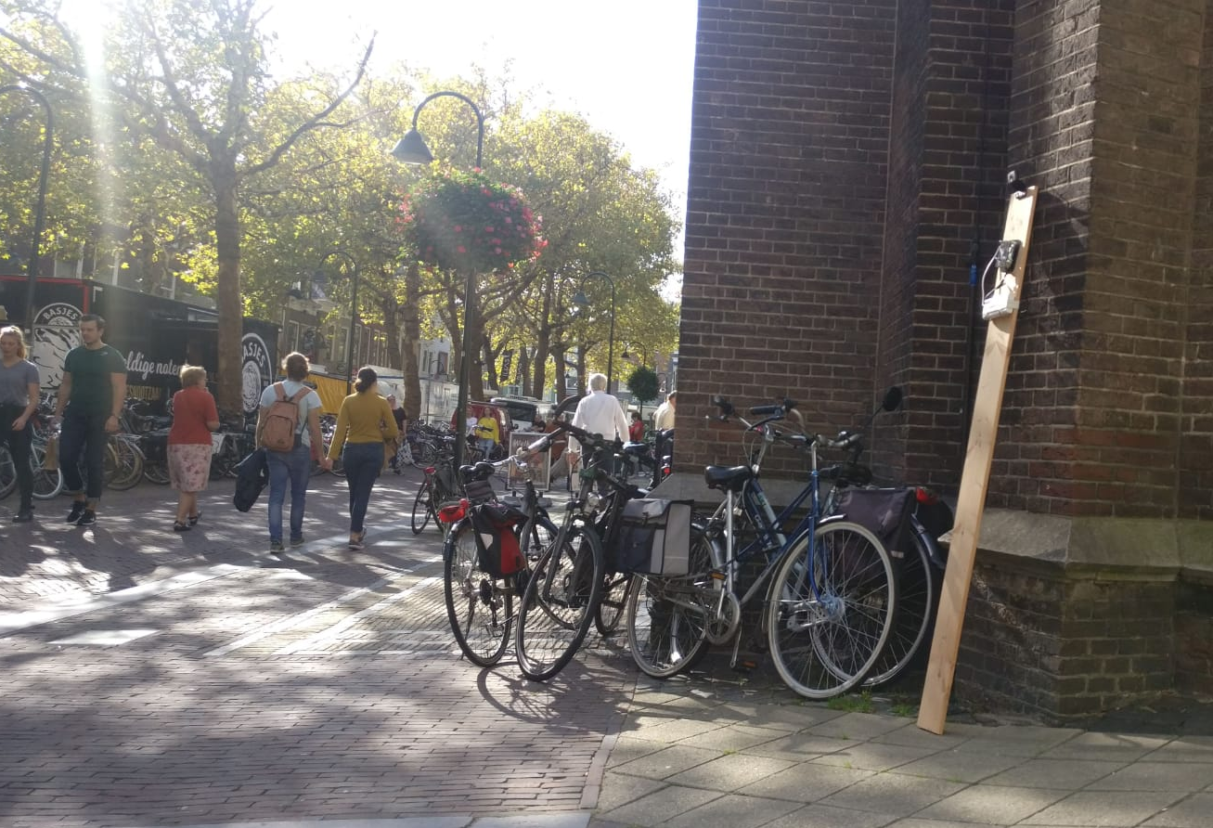
Questions

